Slide 1
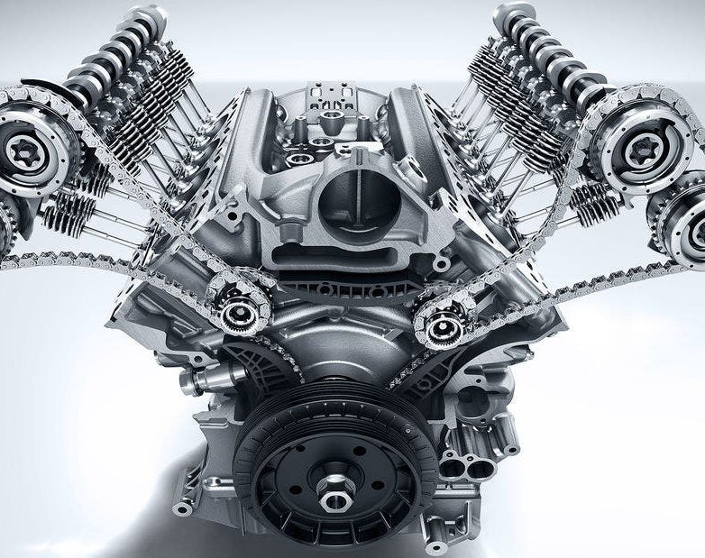
Combustion Engine-4GB10-Interim Presentation
Team 007: Lars van Alen, Thomas Driessen, Dolf Eck, Vito Fransen, Mats van der Heijden, Joey Janssen, Mihai-Dragoş Ungureanu, Alexandra Văcaru

Slide 2
Planning of the presentation
I. Introduction
II. Our Initial Approach
III. Research
A. Thermodynamics & Engine Combustion
B. Bio-Fuels
C. PV diagram
IV. Experiments
A. Plan & Setup
B. Results
V. Future Plans
VI. Question Round

Slide 3

I. Introduction
A gardening company GroenDoen (fictious) decided to opt for a using a greener fuel
A team of 8 people will focus on analyzing this green fuel and see how it react with the Honda GX200 engine
Deadline for the project 19th of March.

Slide 4
II. Our Initial Approach
First a planning + Gantt Chart were made
Secondly each team member did an RPC List (but it was decided to do not use it)
Thirdly, a collaboration platform was made where planning can be seen and working together on code is possible (Gitkraken)
Fourthly, team roles were distributed on a weekly basis

Slide 5
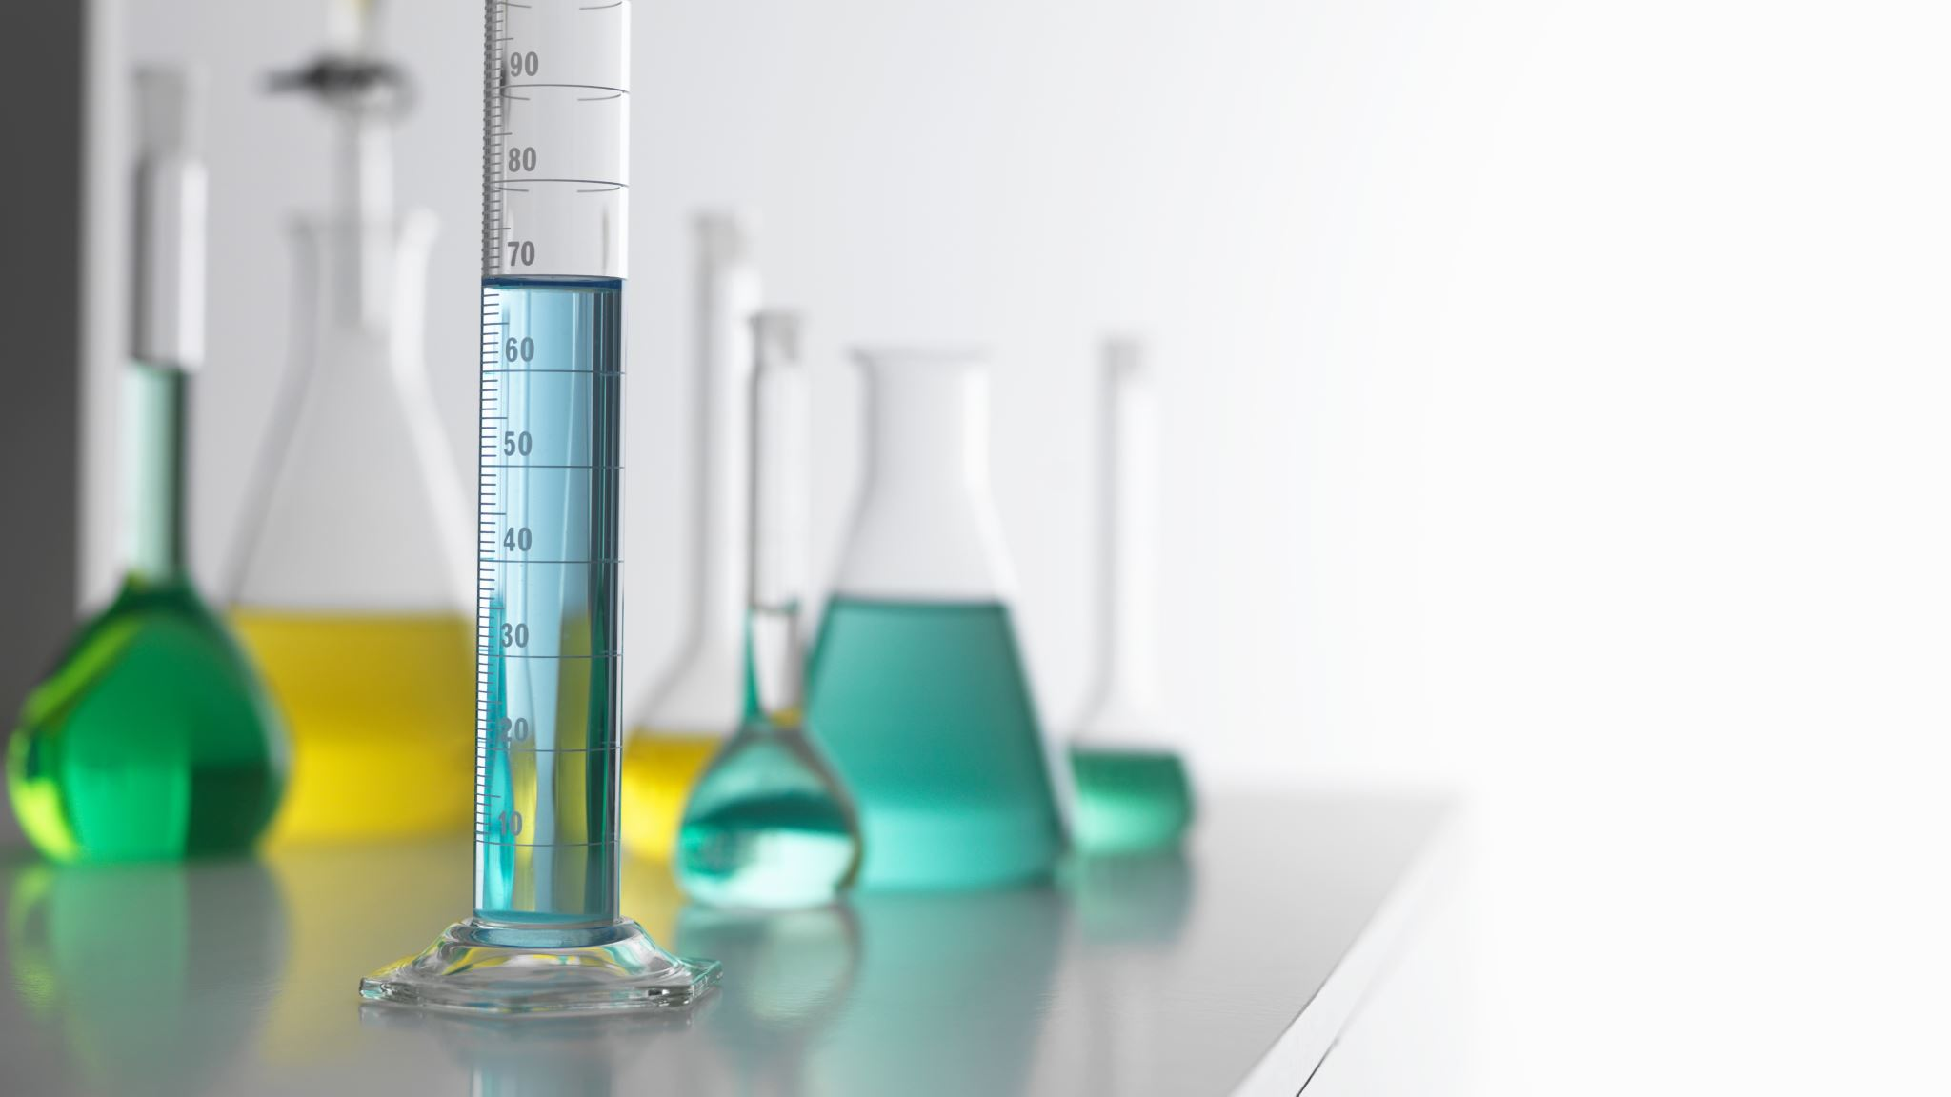
III. Research

Slide 6
A. Thermodynamics & Engine Combustion

Slide 7
B. Bio-Fuels

Slide 8
C. PV Diagram

Slide 9
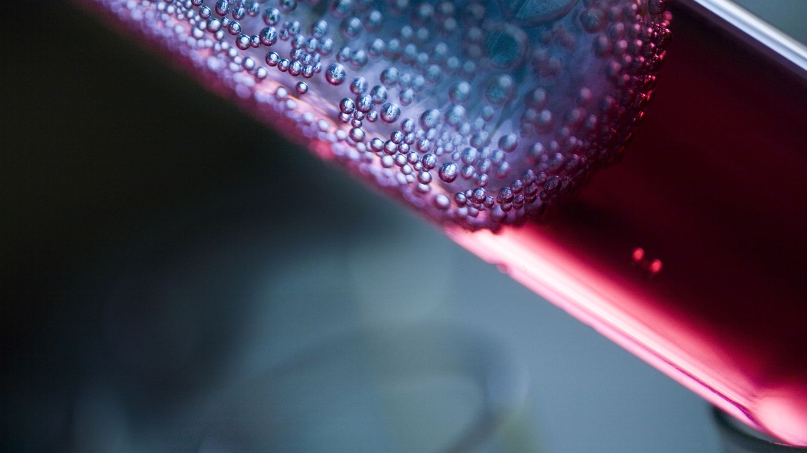
IV. Experiments

Slide 10
A. Plan & Setup

Slide 11
B. Results

Slide 12

V. Future plans

Slide 13
Future implementations

Slide 14

VI. Question Round

